Slide 1
MIS547
Cloud Computing

Slide 2
Admin
Assignment 2 Due Sunday, September 8 at midnight
Quiz 2 Opens Thursday, due Sunday, September 8 at midnight

Slide 3
Assignment 1
Questions?
Comments?
What went well?
What wasn’t fun?
Bug fixes from Week 1:
Add instructions to run pyenv update after installation
Move the set Execution Policy to after pyenv installation
Fix broken link in GitHub student pack signup
Improve language around cloning GitHub repository
Add missing date in Syllabus
Thank you to everyone who posted their questions and issues!!
And thank you to everyone who responded!

Slide 4
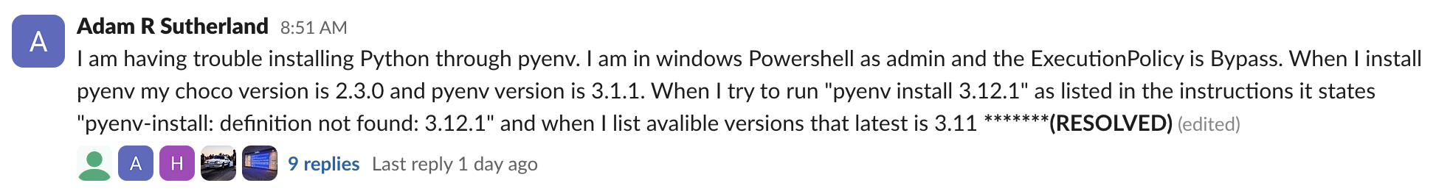

Special acknowledgements: Slack
Hari- first to ask a question in Slack!
Adam- most answers
Skye- eye for detail (found missing date in syllabus)
Adam- best question
Please mark correct answers (or answers that solved the underlying issue with the green checkmark! )

Slide 5
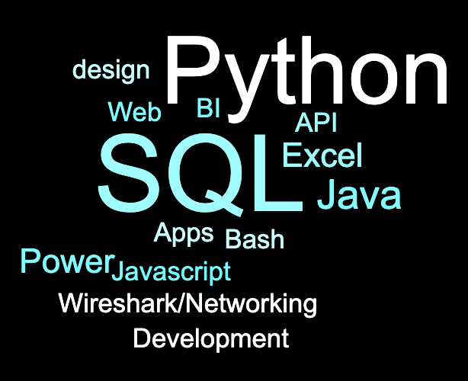
Pre-Assessment Results
Question: What are your top 3 technical skills?

Slide 6
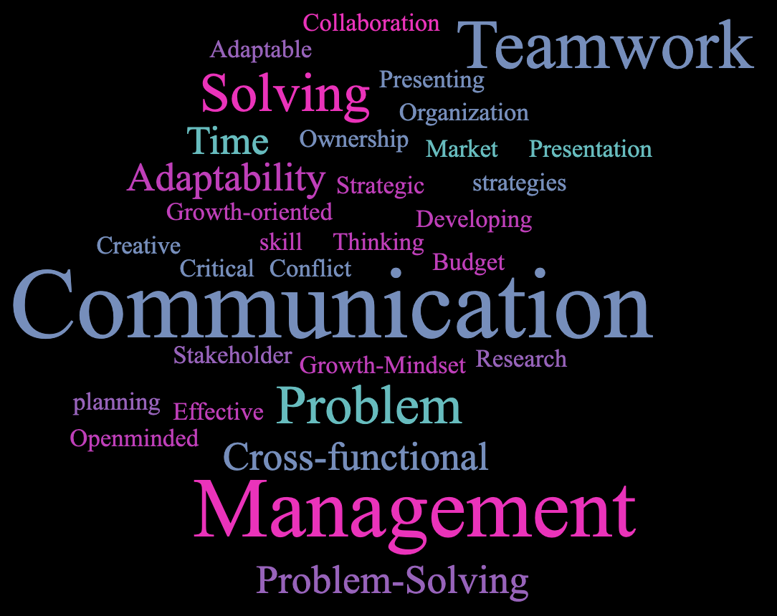
Pre-Assessment Results
Question: What are your top 3 soft skills?

Slide 7
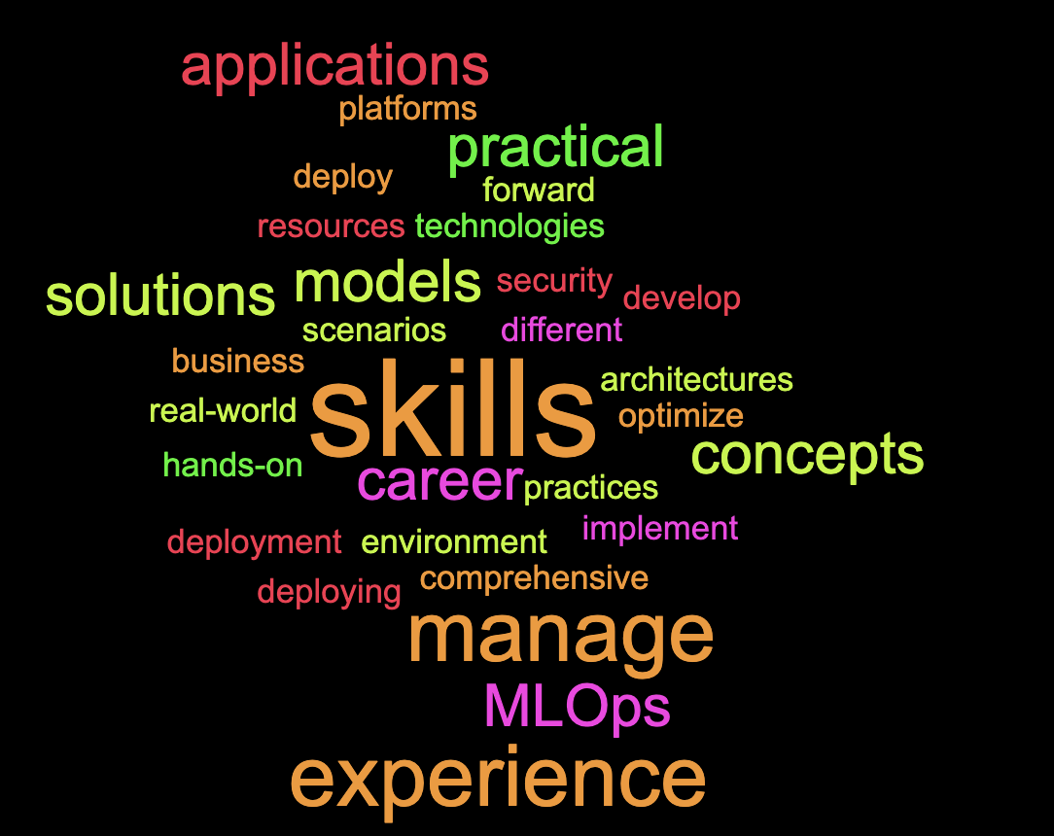
Pre-Assessment Results
Question: What would you most like to get out of this class?

Slide 8
Group Project Overview
Business Problem
Model
Architecture
Fictious or real-world business problem that can be solved with an ML/AI solution
Appropriately fits the task and data
Data storage, data preprocessing, model training, and model inferencing, with a working API endpoint for inference
Host on DigitalOcean

Slide 9
Group Project Overview
Although this isn’t a ML/AI class, you will be expected to either have or learn the fundamentals of appropriately scoping an ML model for a business problem.
When choosing your groups, think critically about working with your friends vs. working with colleagues who have different skills than you. ..

Slide 10
Group Project Overview
ML & MLOps in a business setting is HIGHLY INTERDISCIPLINARY
Machine learning research
Machine learning engineering
DevOps
Security
Networking
Product& project management
Database design & optimization
OBSERVATIONS FROM INDUSTRY
Mgmt doesn’t know the difference between ML research and ML development/ engineering.
Mgmt doesn’t understand the unique security and DevOps requirements for ML systems.
Mgmt doesn’t know what “AI” is.
Mgmt doesn’t know the difference between data science and data engineering.

Slide 11
Group Project Team Formation
4 groups of 4
Self-enroll
Due September 10

Slide 12
Lecture 3: Compute

Slide 13
Recall from Lecture 1…
Characteristics of Cloud Computing
On-demand usage (self-service usage)
Ubiquitous* access
Multitenancy (resource pooling)
Elasticity
Measured Usage
Resiliency

Slide 14
Recall from Lecture 1…
This lecture maps to:
On-demand usage (self-service usage)
Ubiquitous* access
Multitenancy (resource pooling)
Elasticity
Measured Usage
Resiliency

Slide 15

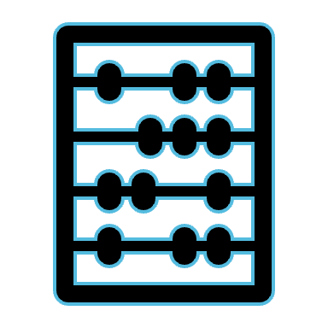




Six Advantages of Cloud Computing
Recall from lecture 1…
Trade capital expense for variable expense
Benefit from massive economies of scale
Stop guessing capacity
Increase speed and agility
Stop spending money running data centers
Go global in minutes

Slide 16
This lecture maps to:
Recall from lecture 1…
Trade capital expense for variable expense
Benefit from massive economies of scale
Stop guessing capacity
Increase speed and agility
Stop spending money running data centers
Go global in minutes

Slide 17
Cloud-Enabling Technologies
What’s covered in this lecture:
Virtualization
Hypervisors
Virtual Machines
Virtual Machine Images
Virtual Machine Resources
Images
Sizes

Slide 18
Virtualization

Slide 19
What is Virtualization?
The abstraction of some physical component into a logical object
The process of converting a physical IT resource into a virtual IT resource
The process of creating a software-based version of something
Notes:
Virtualization is abstracting physical objects into logical objects.
What does that mean?
It’s the process of taking physical IT resources and turning them into virtual software-based resources.
It’s the slicing of IT hardware into partitions by implementing virtualization technology on top of the IT hardware
Convert physical infrastructure into virtual servers, virtual storage, virtual networks, and so on.

Slide 20


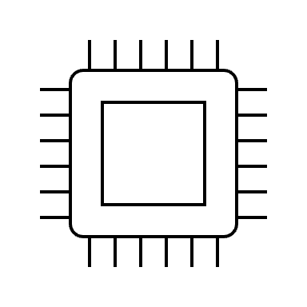
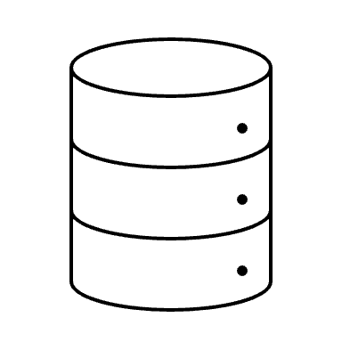
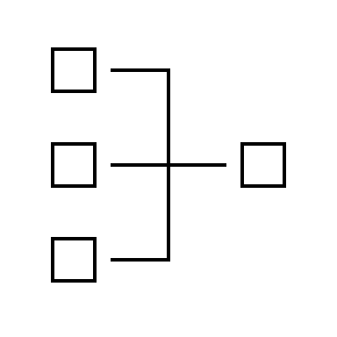
Virtualization
Hardware
Notes:
Let’s say this developer is you. You’re working on your laptop.
It’s a good laptop! It has a CPU, a disk, some networking interfaces, maybe even a GPU.
This is your physical infrastructure.
It’s running Windows 10, and it’s underlying hardware is your CPU, maybe GPU, your disk, and your network interfaces.

Slide 21
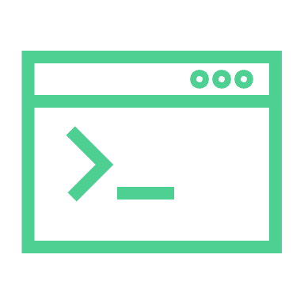
Virtualization
VSCode
Spotify
StackOverflow
Applications
Windows 10
Hardware
Notes:
Maybe you’re developing an application on your laptop.
And maybe to keep your spirits up, you’re playing music on spotify,
And if you’ve like most developer, you have got a few dozen tabs open in a web browser (half of them will be StackOverflow).
Between the applications you’re running and the hardware in your laptop, you have the operating system. Let’s say this is Windows 10.
Your OS is responsible for allocating resources to the applications running on it.
ASK THE CLASS: What are these resources?

Slide 22

Virtualization
Windows 11
Ubuntu
Kali
Windows 10
Notes:
Your application is working great locally. But you need to test it on Windows 11, because it’s 2024.
There’s also a requirement for the application to have Ubuntu support. So now you need to make sure you can test on Ubuntu.
You also have an interest in getting into some cybersecurity pentesting.
You’ve heard about something called Kali Linux, and you want to play around with it.
So now you need dedicated hardware to be able to run Windows 11, Ubuntu, and Kali, right?

Slide 23






Virtualization
Windows 11 (guest)
Ubuntu (guest)
Kali (guest)
Guest Operating Systems
Hypervisor
Host Operating System (Windows 10)
Shared Hardware
Notes:
This is where virtualization comes in!
With virtualization, you can run these other operating systems without needing any additional hardware!
You can share your laptop’s physical resources, like CPU, RAM, Storage, and Network.
Virtualization software makes it possible to run another operating system on top of your operating system.
Virtualization software runs on a physical server called a host,
whose underlying hardware is made accessible to guests, or operating systems running on top of it,
by the virtualization software.
This software is called a hypervisor

Slide 24
Hypervisors

Slide 25
What is a Hypervisor
Software that runs on a compute host (laptop, desktop, server) that virtualizes its underlying hardware resources.
Takes CPU, memory, and network and divides it into subparts (partitions)

Slide 26
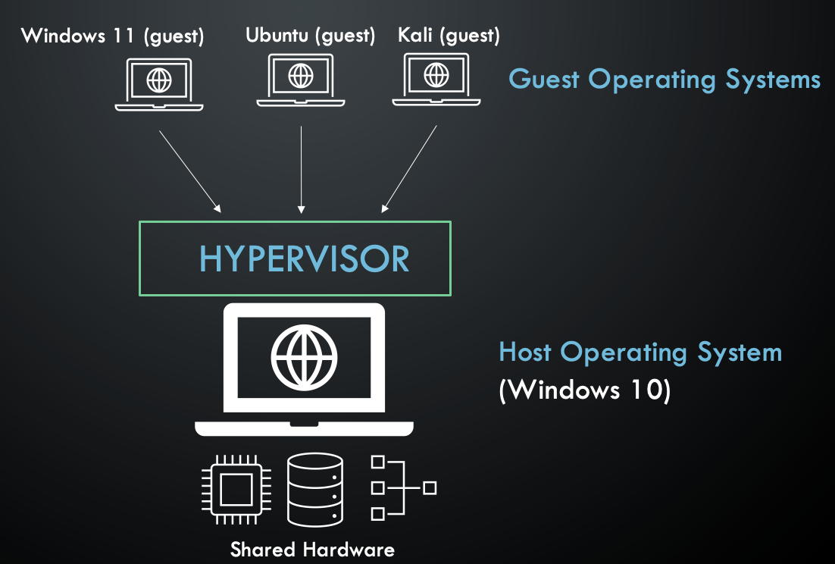
What is a Hypervisor
Guest OS
Hypervisor
Host OS
Hardware
Notes:
To run additional OS’s on top of our Windows 10 OS, we need virtualization software, or a hypervisor, between the host OS, and the guest OS’s.

Slide 27
What is a Hypervisors
VirtualBox (Oracle)
Creates virtual CPU, virtual RAM, virtual storage for each guest
Virtual Machines
Can only give a VM the hardware resources you have available
Notes:
One common and open source tool for this is Virtual Box from Oracle.
Multi Platform- runs on Windows, macOS, linux
It’s going to take hardware resources from the host and create virtual CPU, virtual RAM, and virtual storage for each OS guest
These guests are called virtual machines.
The hypervisor faciliatates sharing of hardware resources from the underlying host to run multiple machines.
But it can only give the VM the hardware resources that are available.
If you have 8GB of RAM, and the host is using 4, and one VM uses 4, you have no resources left.
Virtual machines are completely isolated.
The VM thinks its an independent computer, it doesn’t know that it’s a virtual machine.
This separation means that if something happens to the VM, it won’t affect the host machine.
The host OS won’t know that the VM has issues, and it won’t really care.
You can just delete the VM and create a fresh one. (In theory!!!)

Slide 28
Types of Hypervisors
Type 2 Hypervisor
The kind of hypervisor we’ve been describing is known as a Type 2 hypervisor
A type 2 hypervisor is installed on top of the host operating system.
Notes:
When you’re virtualizing your laptop’s resources by installing a hypervisor on top of your operating system you’re using a Type 2 hypervisor.
In this case, we’re going from hardware
to host OS
to hypervisor
to guest OS.
Type 2 HVs are usually used on personal computers.

Slide 29
Types of Hypervisors
Type 1 Hypervisor
Type 2 Hypervisor
Notes:
In Type 1 hypervisors, we’re going from the hardware
directly to the hypervisor
to the guest OS.

Slide 30
Types of Hypervisors
Type 1 Hypervisor
“Bare metal” HV
Used in cloud computing to virtualize server resources
VMs run in their own isolated environment
As a cloud customer, your VM is sharing hardware with other customers
Multitenancy
Notes:
These are called “bare metal” hypervisors. They control hardware resources on behalf of the guest Oss, and you can install any OS on top of it.
This type of HV is used for servers,
it’s what cloud service providers use to virtualize all of our resources for our customers.

Slide 31
Common Type 1 Hypervisors
HyperV
vSphere
KVM
Microsoft
VMWare
Kernel-based VM
Open source
Linux
Often used in private cloud
Notes:
HyperV
Enbaled after a Windows OS install, and accessed through Windows OS
But when you enable hyperV, it inserts itself between the hardware and the OS, the OS that you see is essentially a VM running on the HyperV platform
vSphere
VMWare offers a type 1 hypervisor called vSphere, it’s widely used within orgs to provide virtualization infrastructure and private cloud functionality
Use in public clouds is somewhat limited because of proprietary nature
KVM
Kernel-based VM, open-source Linux-based hypervisor. Uses a loadable kenable module named kvm.ko and a platform-specific model, either kvm-intel.ko or kvm-amd.ko. KVM supports a wide variety of Windows and Linux Oss for the guest OS
This is what DigitalOcean uses

Slide 32

Benefits
Type 1 Hypervisor
Efficient hardware resource usage
Users can choose how much CPU, memory, and storage they want because these resources can all be virtualized.
CSP can use up server resources by dividing the server into partitions, that are then used by the VMs.

Slide 33
Benefits, cont.
Abstracts the OS from the hardware!
When OS is installed directly on the hardware, the OS is tightly coupled to that hardware.
THE OLD DAYS: If a hardware component fails and you can’t replace the component (old, or not reparable) the entire machine is useless and everything is gone, the OS, applications, and app data
This is a single point of failure
With virtualization, your OS is portable
Create an image of the OS (including applications and data) and reuse it
The server and the software running on top of it are now independent!

Slide 34
Virtual Machine Images (VMI)
Notes:
Virtual machine images

Slide 35


What is an image?
A portable file generated from the OS
Includes OS, applications, configuration, data
You can make copies of it, have backups, etc.
Snapshots
You can run this image on a different computer with a hypervisor
No longer dependent on any physical server
OS
Apps
Config
Data
VM
HV
Server

Slide 36
Virtual Machine Images
For home use, VirtualBox, VMWare Workstation, etc. publish images
For specific Linux and Windows images, visit their official websites.
To deploy an image on a VM through a CSP, we provide the images for you, or you can bring/build your own.

Slide 37
Virtual Resources

Slide 38
Kinds of Virtual Resources
Virtual Machine (VM)
Virtual Server (VSI)
Virtual Network
Virtual Storage
Virtual Firewall
Load Balancer
Software-defined computer
A VM w/ server software
Pool of virtual nodes connected by virtual links
Pool of storage, provided as needed as virtual space
Software appliance that regulates and controls comms between virtual machines
Distribute network traffic across virtual servers

Slide 39
Practical Applications

Slide 40
Practical Applications
Resource efficiency
Easier management
Minimal downtime
Faster provisioning
Notes:
Before virtualization, each application server needed its own dedicated hardware.
IT shops kept each application running on its own computer for reliability reasons.
Each server ultimately ended up having time where it was underused.
With server virtualization, you run several applications on one server, each one on its own VM and with its own OS, without sacrificing reliability.
In fact, you can improve reliability by using virtualization by taking regular snapshots of your VM
Easier management:
software-defined VMs can be managed via software-defined policies.
Allows you to automate your IT service management.
In code, automate the deployment and configuration that you need to define collections of virtual machines and applications in software templates.
You can install those services repeatedly and consistently
We can also virtualize security processes to mandate certain security configurations.
We’re going to discuss this in depth during our Infrastructure as Code lectures in week 4 or 5
Minimal downtime: adopting virtualization lets us run multiple virtual machines alongside each other,
Failover between them when problems arise.
Running multiple redundant physical servers is more expensive, and failover can be a bit more challenging to handle.
Faster provisioning: buying, installing, and configuring hardware is time-consuming.
With virtualization, once hardware is already in place, you can provision your VMs to run all your applications much faster.

Slide 41
Names for Virtual machines In Different CSPs
AWS
EC2 (Elastic Compute Cloud)
“EC2 Instance”
Azure
Virtual machines
GCP
Compute Engine
VM Instance
DigitalOcean
Droplet

Slide 42
Choosing the Right VM: Image and Size
Image
Linux? Debian? RHEL? Release?
Windows? Version?
Specialized images!!
Size (Resources)
How many CPUs?
How much Memory?
How much Storage?
GPU?
Not all sizes and images are available in all availability zones for every cloud!

Slide 43
Key Takeaways
Virtualization technologies are the foundation of all of cloud computing.
When we create a VM with a CSP what we’re really doing is renting compute, network, and storage resources from them.
We’re spinning up an instance of a virtual machine on the CSP’s hardware.
The server hardware can be shared with other customers
CSPs partition their compute resources by using hypervisors.
An image contains the software that defines what the VM instance will run.

Slide 44
WHERE ARE WE?

Slide 45
Cloud Delivery Models
SaaS
PaaS
IaaS
We are here
AWS EC2 | Azure VMs |
GCP Instances | DO Droplets
Public cloud → IaaS → Compute

Slide 46
Virtual Machine Settings: Understanding the Details

Slide 47
Log in to Azure to follow along
https://portal.azure.com/

Slide 48
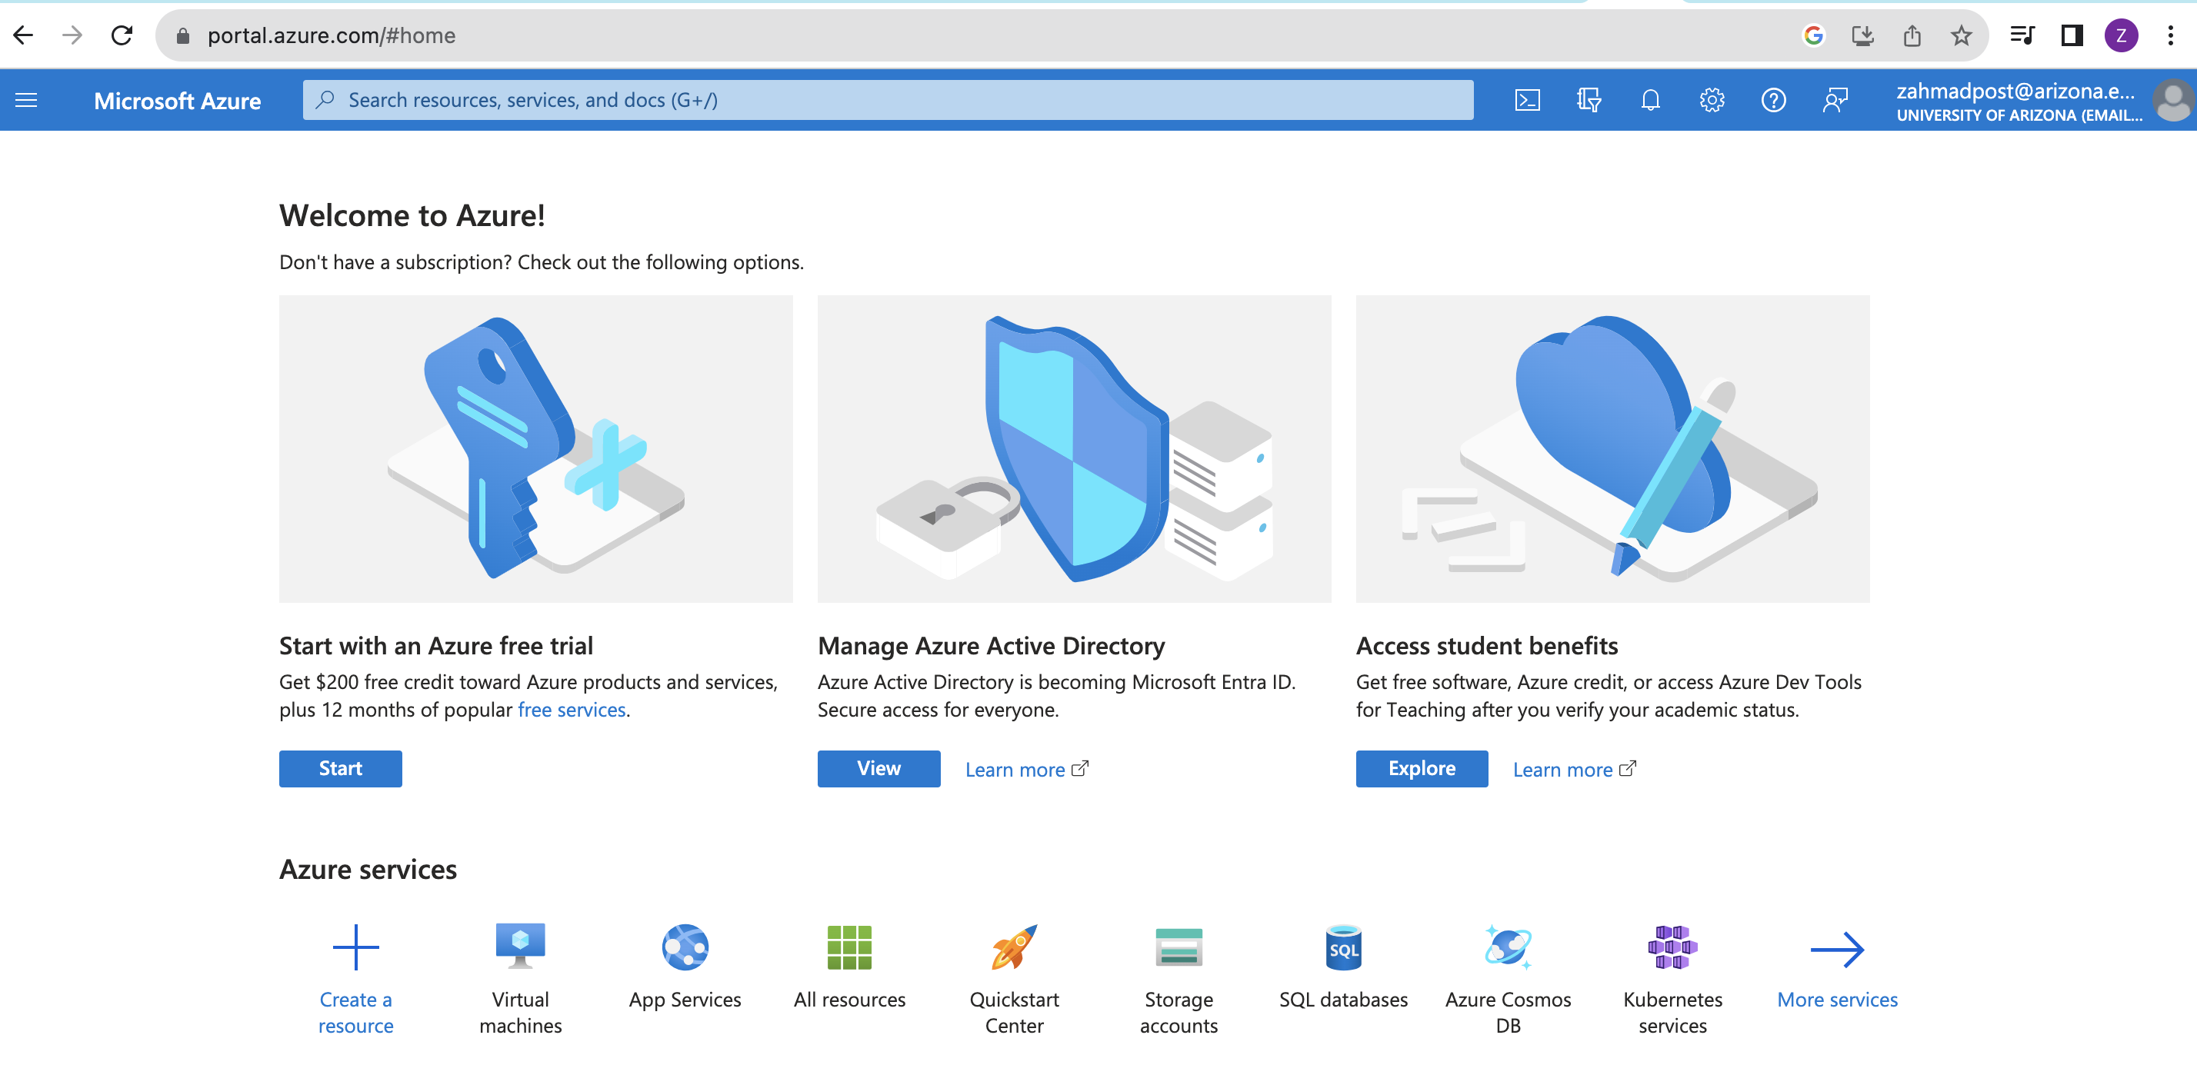
Spinning Up Our First Virtual Machines: Azure Portal

Slide 49
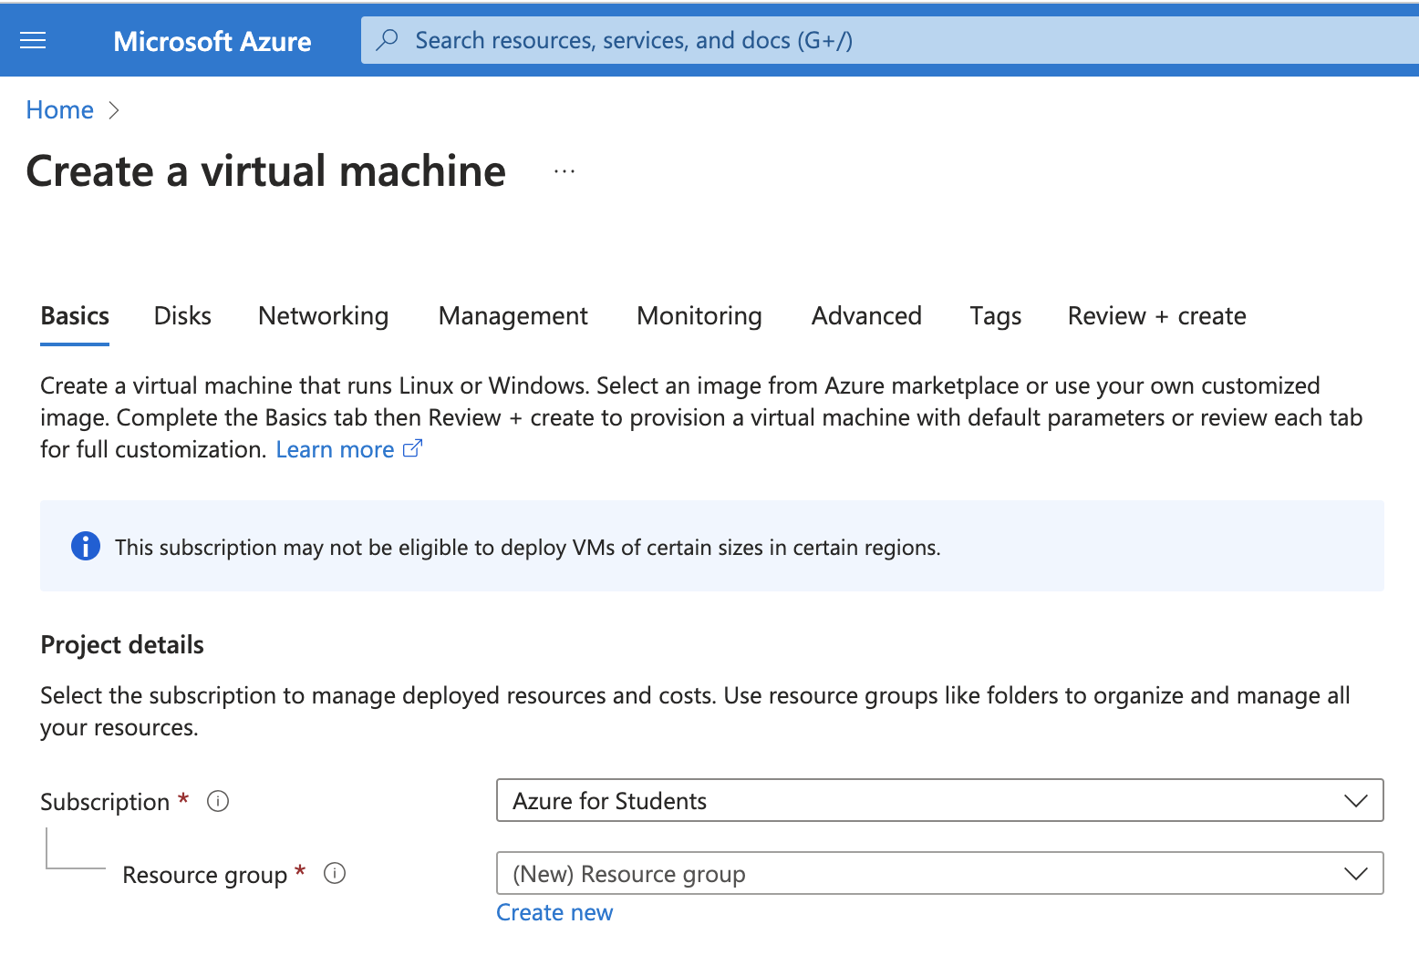
Creating a Virtual Machine
VM Settings:
Subscription: Azure for Students
Resource Group

Slide 50
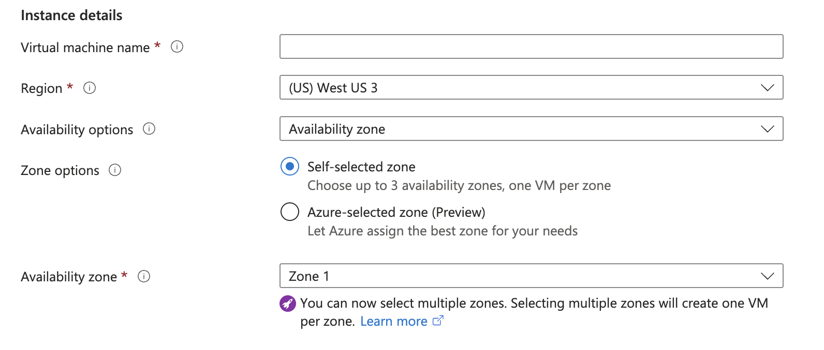
Creating a Virtual Machine, Cont.
Instance details:
Region
Availability options:
Availability zone
Virtual machine scale set
Availability set

Slide 51
High-Availability, Redundancy, Failover
Regions
Availability Zones
Scale sets
Availability sets

Slide 52
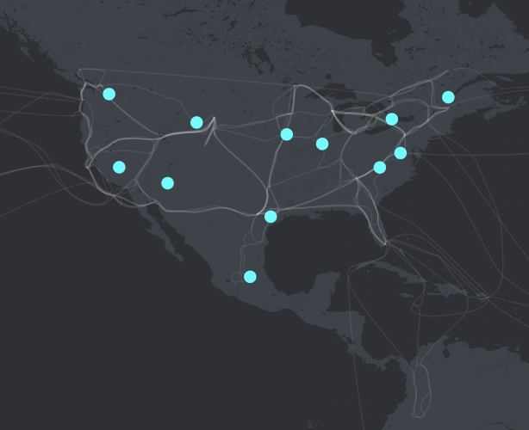
High-Availability, Redundancy, Failover
Regions
CSPs have datacenters all over the world.
You can select where you would like your services and data to reside by choosing a region.
Common: US-East, US-West
Choose a region closest to the highest usage of your resources
US Azure Regions
For an interactive exploration, visit https://datacenters.microsoft.com/globe/explore/

Slide 53
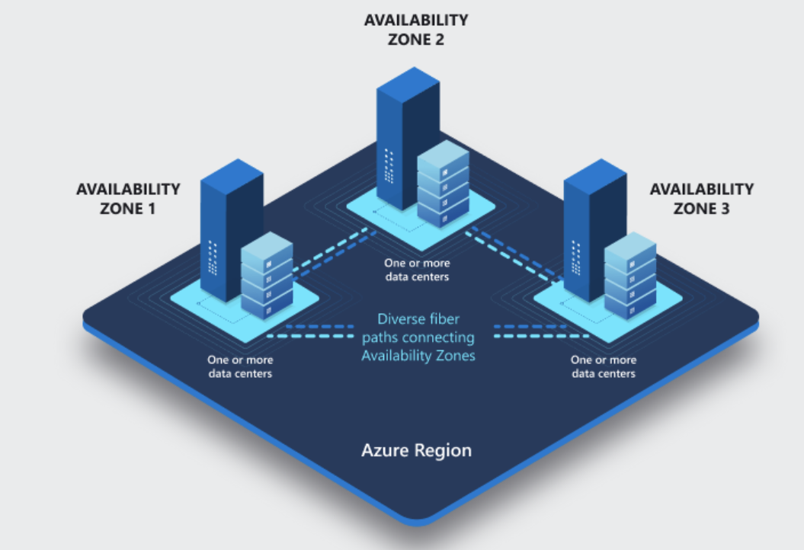
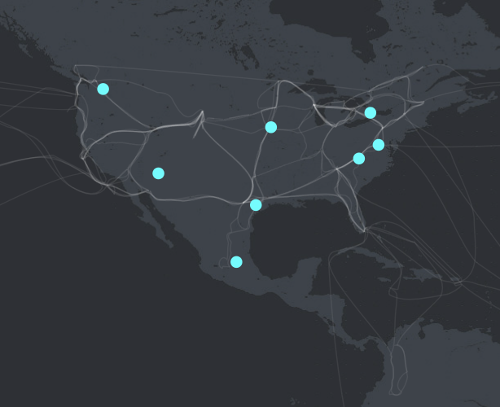
High-Availability, Redundancy, Failover
Availability Zones
Within-region redundant infrastructure
Protections in place in case one datacenter or AZ fails
For an interactive exploration, visit https://datacenters.microsoft.com/globe/explore/

Slide 54
High-Availability, Redundancy, Failover
Availability Zones
Not all Azure regions support AZs.
US Azure Regions that support availability Zones
For an interactive exploration, visit https://datacenters.microsoft.com/globe/explore/

Slide 55
High-Availability, Redundancy, Failover
Scale Sets:
Create a group of load-balanced VMs
Can be provisioned across AZs
Allows applications to scale in response to demand
High-availability of your application
If one VM isn’t available, traffic automatically routed to another available one
We will cover this in great detail in the second-half of the semester

Slide 56
High-Availability, Redundancy, Failover
Availability Sets:
Mitigates single point of failure risks
Automatically duplicate your VM across fault domains
Fault domains define groups of VMs that share the common power source and network switch

Slide 57
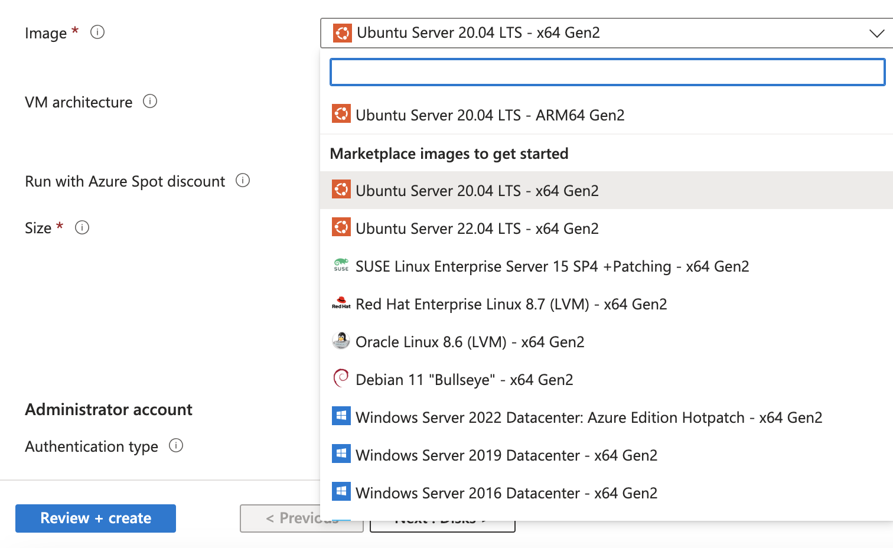
Creating a Virtual Machine, Cont.
Image
Architecture
ARM
x64
Azure Spot Discount

Slide 58
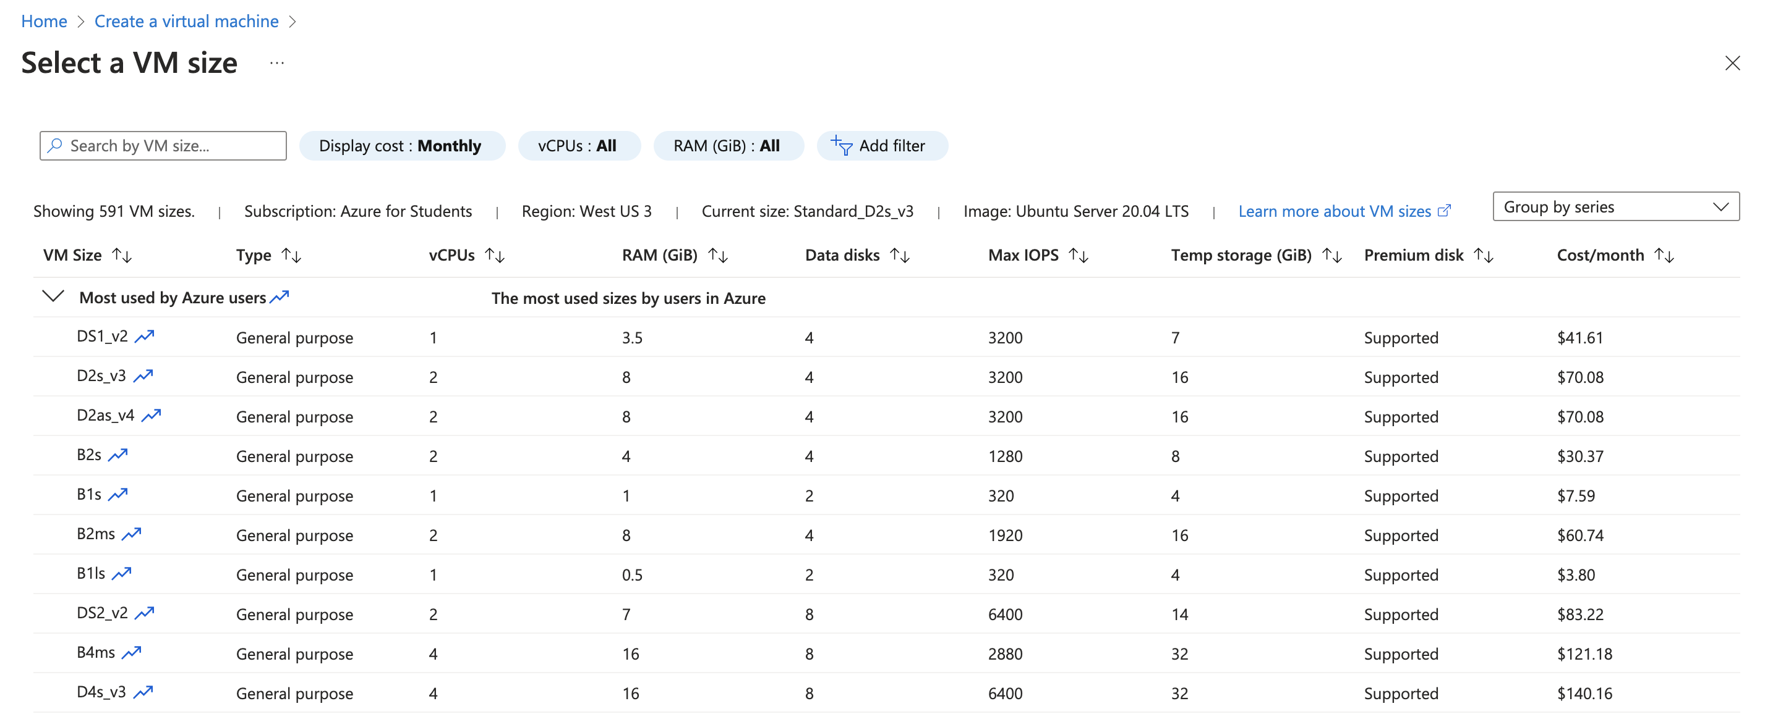
Creating a Virtual Machine, Cont.
Size

Slide 59
Creating a Virtual machine: Size Key Considerations
CPU-to-memory ratio
Disk throughput and IO
Graphics rendering
Model training and inferencing

Slide 60
Creating a Virtual Machine: Types of VMS
Type | Description | Use cases
General purpose | Balances CPU-to-memory ratio | Testing, development, small DBs, low traffic web servers
Compute optimized | High CPU-to-memory ratio | Medium traffic web servers, network appliances, batch processes, application servers
Memory optimized | High memory-to-CPU ratio | Relational DBs, medium caches, in-memory analytics
Storage optimized | High disk throughput & IO | Big data, SQL, NoSQL DBs, data warehousing, large transactional DBs
GPU | Single or multiple GPUs | Heavy graphic rendering, video editing, model training & inferencing
HPC | Powerful CPU with high-throughput network | DNA sequencing, stock trading, IoT data, GPS

Slide 61
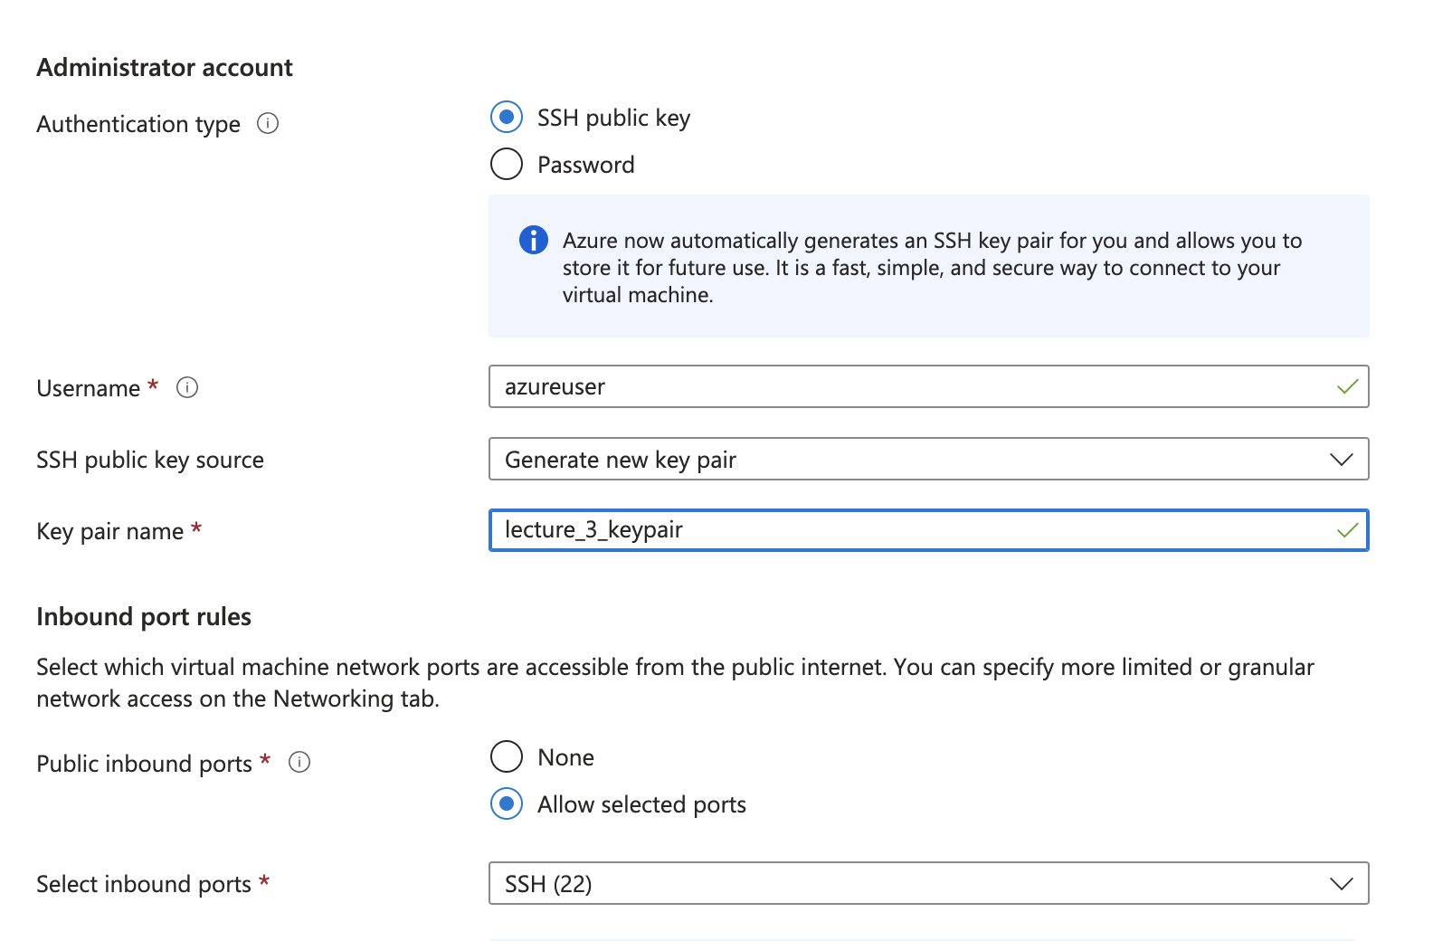
Creating a virtual Machine: Authentication

Slide 62
Authentication
Passwords
Authentication apps
Biometrics
Keys

Slide 63
Authentication using SSH
SSH = secure shell
An SSH Key is an access credential in the SSH protocol.
Functionally, SSH keys resemble passwords.
Public key cryptosystem
Key is made up of two parts: a public key and a private key (key pair)
The public key is for the remote system!
Your private key stays with you!

Slide 64
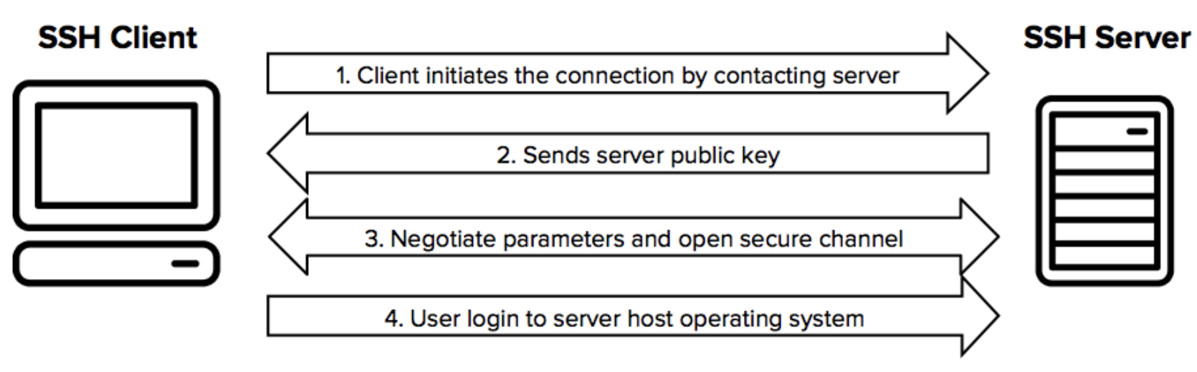
Authentication using SSH
Enables secure system administration and file transfers (SFTP) over insecure networks
SSH protocol uses encryption to secure the connection between a client and a server

Slide 65
Creating a virtual Machine: Inbound Ports
By default, SSH uses port 22. You’ll need to make sure port 22 is open on your remote system or you won’t be able to connect to it!

Slide 66
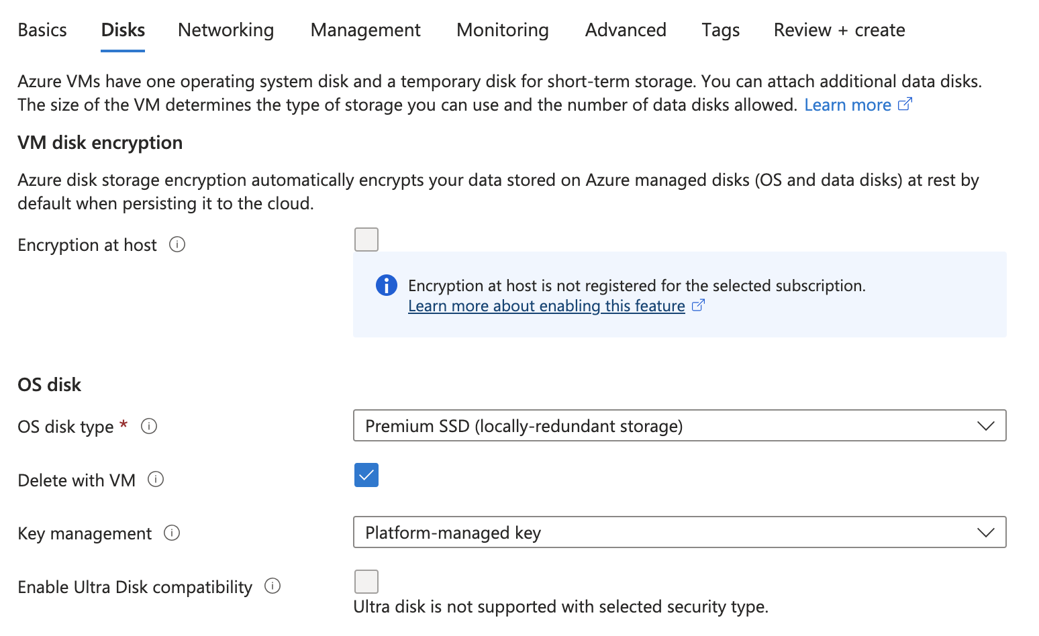
Creating a virtual Machine: Disks

Slide 67
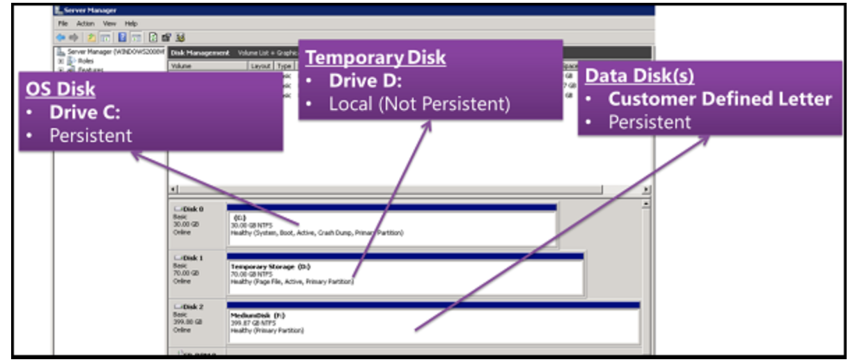
Disks
OS disk
Data disk
Temporary disk

Slide 68
Managed Disks Types
Ultra disks
Premium SSD
Standard SSD
Standard HDD

Slide 69
Managed Disk Types
 | Ultra disk | Premium SSD v2 | Premium SSD | Standard SSD | Standard HDD
Disk type | SSD | SSD | SSD | SSD | HDD
Scenario | IO-intensive workloads: top tier databases (for example, SQL, Oracle), transaction-heavy workloads. | Production and performance-sensitive workloads that require low latency and high IOPS and throughput | Production and performance sensitive workloads | Web servers, lightly used enterprise applications and dev/test | Backup, non-critical, infrequent access
Max disk size | 65,536 GiB | 65,536 GiB | 32,767 GiB | 32,767 GiB | 32,767 GiB
Max throughput | 4,000 MB/s | 1,200 MB/s | 900 MB/s | 750 MB/s | 500 MB/s
Max IOPS | 160,000 | 80,000 | 20,000 | 6,000 | 2,000, 3,000*
Usable as OS Disk? | No | No | Yes | Yes | Yes
IOPS: Input Output per second, measures read/write speed

Slide 70
Managed Disks Benefits
High availability
Scalable VM deployment
Integration with availability sets
Integration with availability zones
Azure backup support

Slide 71
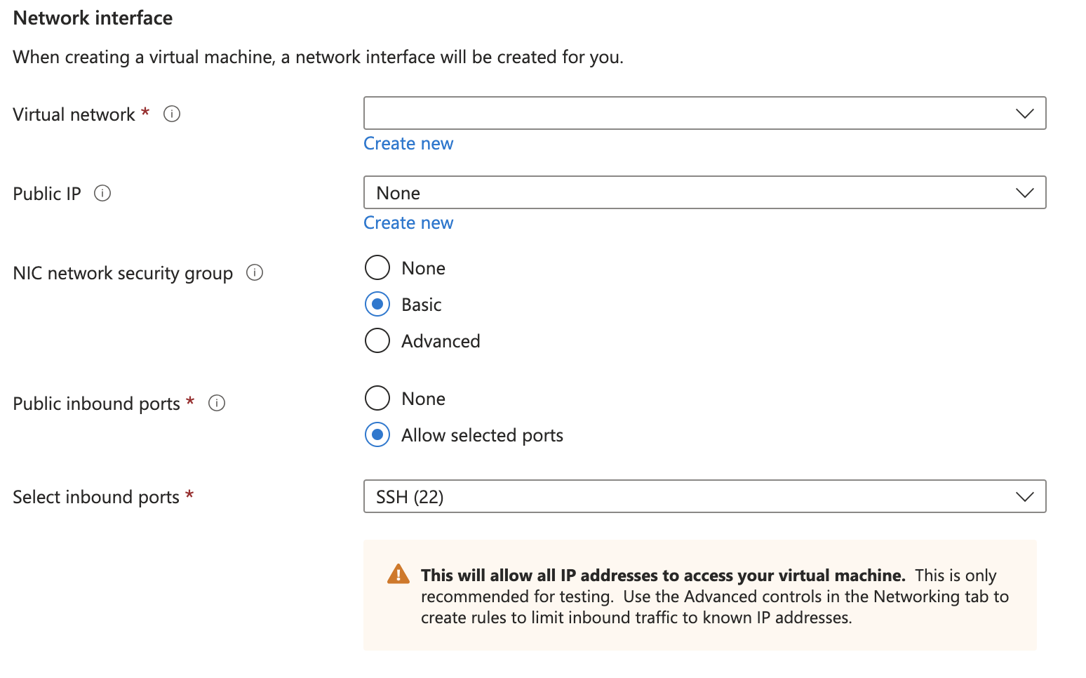
Creating a virtual Machine: Networking

Slide 72
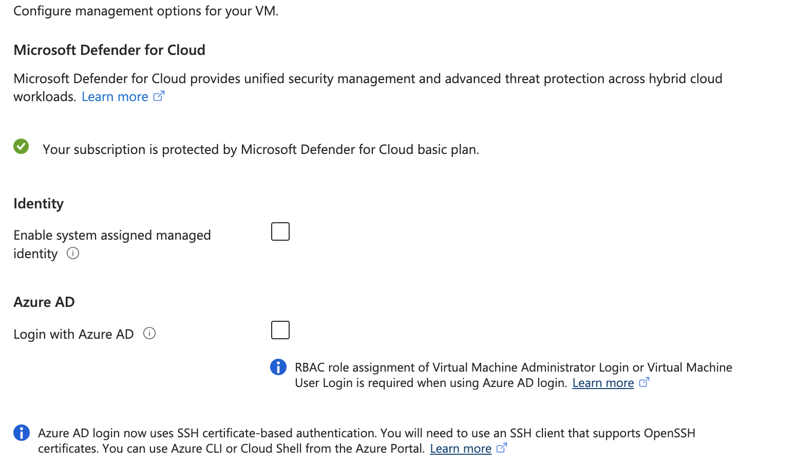
Creating a virtual Machine: Management

Slide 73
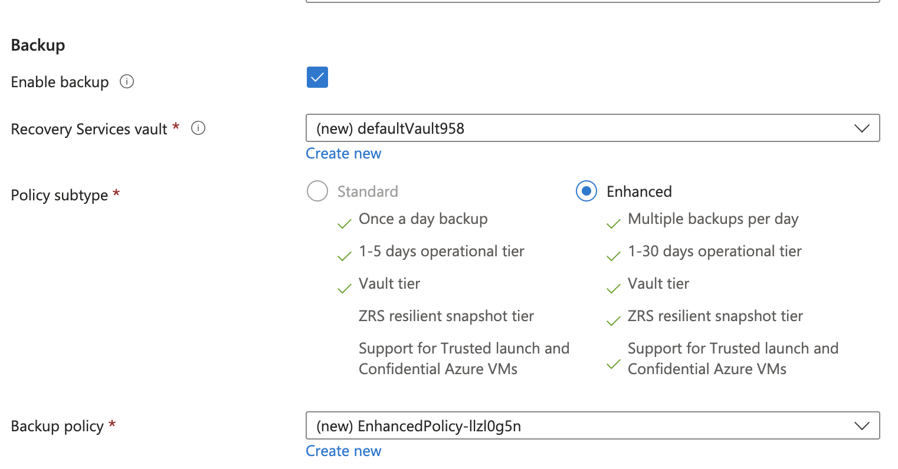
Creating a virtual Machine: Management

Slide 74
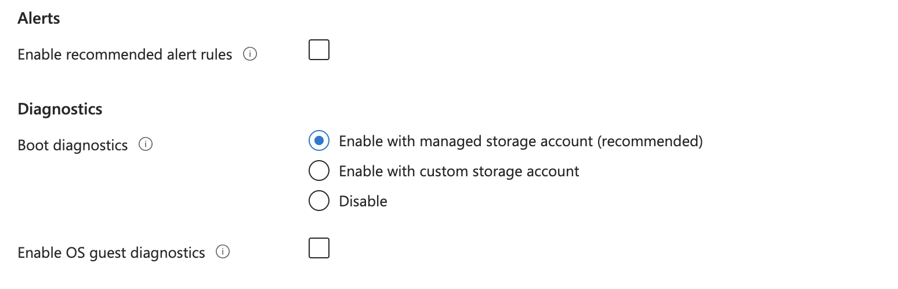
Creating a virtual Machine: Monitoring

Slide 75
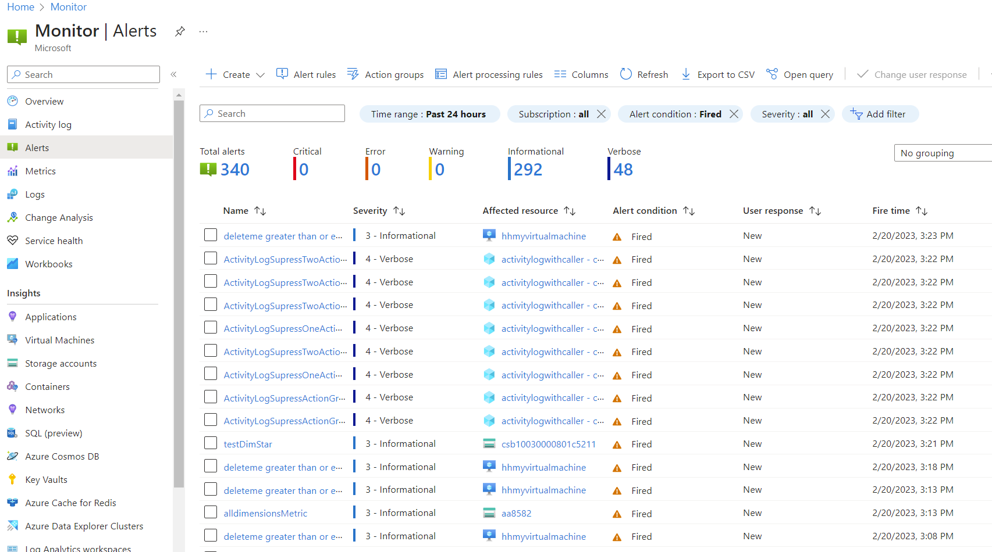
Monitoring

Slide 76
Walk-Throughs Available on d2L
Week 2 resources
Azure, GCP, AWS
Week 2 assignment- creating and using VMs on DigitalOcean

Slide 77
THANK YOU!

Slide 78
Land Acknowledgement Statement
We respectfully acknowledge the University of Arizona is on the land and territories of Indigenous peoples. Today, Arizona is home to 22 federally-recognized tribes, with Tucson being home to the O’odham and the Yacqui. Committed to diversity and inclusion, the University strives to build sustainable relationships with sovereign Native Nations and Indigenous communities through education offerings, partnerships, and community service.

Slide 79
Back-Up Slides
More details about Azure VMs
Installing nginx
Connecting to Azure VM

Slide 80
Steps to Create a VM In AZURE
1. Sign into the Azure Portal
2. Under Services, select Virtual Machines
3. In the Virtual machines page, select Create and then Virtual machine.
4. In the Basics tab, under Project details, select the Student subscription
5. Create a new resource group (MIS547Lecture3)

Slide 81
Steps to Create a VM in Azure
6. Under Instance details for Virtual machine name, type MIS547lecture3
7. Choose Ubuntu Server 22.04 LTS – Gen 2 for your image
8. Leave other defaults as they are
9. Under administrator account, select SSH public key
10. In Username enter azureuser
11. For SSH public key source, leave the default of Generate new key pair and then enter mis547lecture3key for the key pair name

Slide 82
Steps to create a VM in Azure
12. Under Inbound port rules > Public inbound ports, choose Allow selected ports
13. Select SSH (22) and HTTP (80) from the drop-down
14. Leave the remaining defaults on the basics page and then select the Review and create button
15. On the create virtual machine page, you can see details about the VM you are about to create

Slide 83
Steps to create a VM in Azure
16. When the generate new key pair window opens, select Download private key and create resource. Your key file will be downloaded as mis547lecture3key.pem
17. When the deployment is finished, select Go to resource
18. Select the pubic IP address and copy it to your clipboard

Slide 84
Steps to create a VM in Azure
19. On the Networking Settings page, select more options, then reset password
20. Reset the administrator password:
Username: azureuser
Password: whateverYourPasswordIs

Slide 85
Access your VM!
21. If you are on Mac or Linux, open a bash prompt and set read-only permission on the .pem file:
chmod 400 ~/Downloads/mis547lecture3key.pem
22. If you’re on Windows, open a PowerShell prompt
23. At your prompt open an SSH connection to your virtual machine. Replace the IP address with the one from your VM and replace the path to the .pem with the path to where the key file was downloaded:
ssh –i ~/Downloads/mis547lecture3key.pem azureuser@10.111.12.123

Slide 86
Install nginx
24. We’re going to install nginx on our VM!
25. Once you’ve SSH’d into your VM, type the following in your terminal:
sudo apt-get –y update
sudo apt-get –y install nginx
Now navigate to the public IP address listed in your VM set up!

